Slide 1
Chapter 3: Processes

Slide 2
Chapter 3: Processes
Process Concept
Process Scheduling
Operations on Processes
Cooperating Processes
Interprocess Communication
Communication in Client-Server Systems

Slide 3
Multiprogramming
Computers (at least uniprocessors) don’t really run multiple programs simultaneously, it just looks that way
Each process runs to completion, but is interleaved with other processes
As a process runs, it may have to wait for things like user input or disk I/O
While one process waits, another can run
This is multiprogramming

Slide 4
Process Concept
An operating system executes a variety of programs:
  Batch system – jobs
  Time-shared systems – user programs or tasks
Textbook uses the terms job and process almost interchangeably
Process – a program in execution; process execution must progress in sequential fashion
A process includes:
  program counter
  stack
  data section
  code
  heap
  allocated memory

Slide 5

Processes in Memory
Process A
Process B

Slide 6
Processes and Scheduling
Processes have isolation from each other
  Address space
  Security context
  Termination protection
Processes are scheduled separately from each other
One process blocking or being pre-empted allows another to run
On some systems, a process can be composed of several threads which share the process
On a multiprocessor, processes can and do run simultaneously

Slide 7

Diagram of Process State
As a process executes, it changes state
  new: The process is being created
  running: Instructions are being executed
  waiting: The process is waiting for some event to occur
  ready: The process is waiting to be assigned to a process
  terminated: The process has finished execution

Slide 8

Process Control Block (PCB)
Information associated with each process:
Process state
Program counter
CPU registers
CPU scheduling information
Memory-management information
Accounting information
I/O status information

Slide 9
Context Switch
When CPU switches to another process, the system must save the state of the old process and load the saved state for the new process
Context-switch time is overhead; the system does no useful work while switching
Time dependent on hardware support

Slide 10

CPU Switch From Process to Process

Slide 11
Processes and System Calls
What happens on a system call?
  PSW, registers are saved
  Branches to appropriate system call
  This requires a stack
Kernel stacks
  Can’t trust a user level stack
  Stack size is limited (4K or 8K)
  Stacks can’t be shared across processes
  Need a separate kernel stack per process
  *PSW =The Program Status Word (PSW) contains status bits that reflect the current CPU state

Slide 12
Process Scheduling Queues
Job queue – Set of all processes in the system
Ready queue – Set of all processes residing in main memory, ready and waiting to execute
Device queues – Set of processes waiting for an I/O device
Processes migrate among the various queues

Slide 13

Ready Queue And Various I/O Device Queues

Slide 14

Representation of Process Scheduling

Slide 15
Schedulers
Long-term scheduler (or job scheduler) – selects which processes should be brought into the ready queue
Short-term scheduler (or CPU scheduler) – selects which process should be executed next and allocates CPU

Slide 16

Addition of Medium Term Scheduling

Slide 17
Schedulers (Cont.)
Short-term scheduler is invoked very frequently (milliseconds) ⇒ (must be fast)
Long-term scheduler is invoked very infrequently (seconds, minutes) ⇒ (may be slow)
The long-term scheduler controls the degree of multiprogramming
Processes can be described as either:
  I/O-bound process – spends more time doing I/O than computations, many short CPU bursts
  CPU-bound process – spends more time doing computations; few very long CPU bursts

Slide 18

A tree of processes on a typical Solaris

Slide 19
Process Creation
Parent process create children processes, which, in turn create other processes, forming a tree of processes
Resource sharing
  Parent and children share all resources
  Children share subset of parent’s resources
  Parent and child share no resources
Execution
  Parent and children execute concurrently
  Parent waits until children terminate

Slide 20
Process Creation (Cont.)
Address space
  Child duplicate of parent
  Child has a program loaded into it
UNIX examples
  fork system call creates new process
  exec system call used after a fork to replace the process’ memory space with a new program

Slide 21

Process Creation

Slide 22
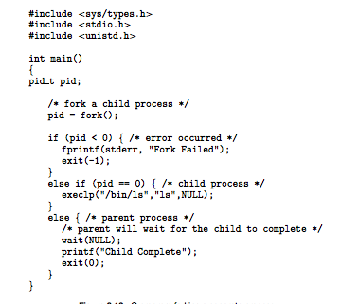
Process Creation in POSIX

Slide 23
Process Creation in UNIX
Newly-created process is a child of the parent process
Creates an exact copy of the process:
  Code, data, state
  Example state: file descriptors
Parent is notified when a child terminates, and needs to “reap” it via the wait() system call
If not, process remains a zombie
Processes whose parent dies become children of process 1

Slide 24
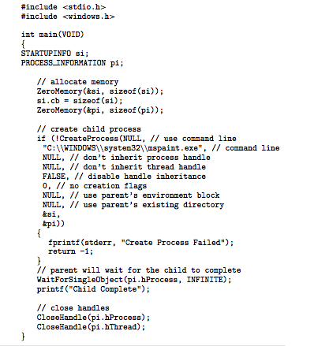
Process Creation in Win32

Slide 25
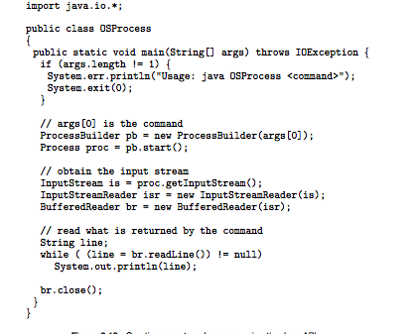
Process Creation in Java

Slide 26
Process Termination
Process executes last statement and asks the operating system to delete it (exit)
  Output data from child to parent (via wait)
  Process’ resources are deallocated by operating system
Parent may terminate execution of children processes (abort)
  Child has exceeded allocated resources
  Task assigned to child is no longer required
  If parent is exiting
    Some operating system do not allow child to continue if its parent terminates
      All children terminated - cascading termination

Slide 27
Cooperating Processes
Independent process cannot affect or be affected by the execution of another process.
Cooperating process can affect or be affected by the execution of another process
Advantages of process cooperation
  Information sharing
  Computation speed-up
  Modularity/Convenience

Slide 28
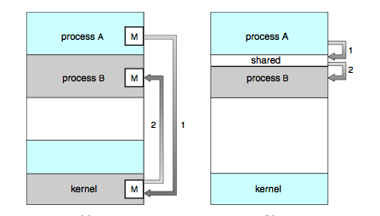
Interprocess Communication
Message Passing Shared Memory

Slide 29
Producer-Consumer Problem
Paradigm for cooperating processes, producer process produces information that is consumed by a consumer process
  unbounded-buffer places no practical limit on the size of the buffer
  bounded-buffer assumes that there is a fixed buffer size

Slide 30
Bounded-Buffer – Shared-Memory Solution
How to share memory in Linux?
      int key = 1234;
      int size = 1024 * 1024;
      int flags = 666 | IPC_CREAT;
      int shmid;
      char * data;
      shmid = shmget(key, size, flags);
      if (shmid == -1)
      perror(shmget);
      data = shmat(shmid, 0, 0);
      if (data == (char *)(-1))
      perror("shmat");

Slide 31
Bounded-Buffer – Shared-Memory Solution
Shared data
      int *in = (int *) data++;
      int *out = (int *) data++;
      #define BUFFER_SIZE 10
      typedef struct {
      . . .
      } item;
      item *buffer[BUFFER_SIZE];
      buffer = (item *) data;
      *in = *out = 0;
Solution is correct, but can only use BUFFER_SIZE - 1 elements

Slide 32
Bounded-Buffer – Producer Process
item nextProduced;
while (1) {
while (((*in + 1) % BUFFER_SIZE) == *out)
; /* busy wait, do nothing */
buffer[*in] = nextProduced;
*in = (*in + 1) % BUFFER_SIZE;
}

Slide 33
Bounded-Buffer – Consumer Process
item nextConsumed;
while (1) {
while (*in == *out)
; /* busy wait, do nothing */
nextConsumed = buffer[*out];
*out = (*out + 1) % BUFFER_SIZE;
}

Slide 34
Message Passing
Message system – processes communicate with each other without resorting to shared variables
Message passing facility provides two operations:
  send(message) – message size fixed or variable
  receive(message)
If P and Q wish to communicate, they need to:
  establish a communication link between them
  exchange messages via send/receive
Implementation of communication link
  physical (e.g., shared memory, hardware bus)
  logical (e.g., logical properties)

Slide 35
Implementation Questions
How are links established?
Can a link be associated with more than two processes?
How many links can there be between every pair of communicating processes?
What is the capacity of a link?
Is the size of a message that the link can accommodate fixed or variable?
Is a link unidirectional or bi-directional?

Slide 36
Direct Communication
Processes must name each other explicitly:
  send (P, message) – send a message to process P
  receive(Q, message) – receive a message from process Q
Properties of communication link
  Links are established automatically
  A link is associated with exactly one pair of communicating processes
  Between each pair there exists exactly one link
  The link may be unidirectional, but is usually bi-directional

Slide 37
Indirect Communication
Messages are directed and received from mailboxes (also referred to as ports)
  Each mailbox has a unique id
  Processes can communicate only if they share a mailbox
Properties of communication link
  Link established only if processes share a common mailbox
  A link may be associated with many processes
  Each pair of processes may share several communication links
  Link may be unidirectional or bi-directional

Slide 38
Indirect Communication
Operations
  create a new mailbox
  send and receive messages through mailbox
  destroy a mailbox
Primitives are defined as:
send(A, message) – send a message to mailbox A
receive(A, message) – receive a message from mailbox A

Slide 39
Indirect Communication
Mailbox sharing
  P₁, P₂, and P₃ share mailbox A
  P₁, sends; P₂ and P₃ receive
  Who gets the message?
Solutions
  Allow a link to be associated with at most two processes
  Allow only one process at a time to execute a receive operation
  Allow the system to select arbitrarily the receiver. Sender is notified who the receiver was.

Slide 40
Synchronization
Message passing may be either blocking or non-blocking
Blocking is considered synchronous
  Blocking send has the sender block until the message is received
  Blocking receive has the receiver block until a message is available
Non-blocking is considered asynchronous
  Non-blocking send has the sender send the message and continue
  Non-blocking receive has the receiver receive a valid message or null

Slide 41
Buffering
Queue of messages attached to the link; implemented in one of three ways
  1. Zero capacity – 0 messages
  Sender must wait for receiver (rendezvous)
  2. Bounded capacity – finite length of n messages
  Sender must wait if link full
  3. Unbounded capacity – infinite length
  Sender never waits

Slide 42
Bounded-Buffer – Message Passing
Example: Message queues in Linux
  Indirect communication
  Blocking or non-blocking (your choice)
      int key = ftok("/home/nahum/blah", 1);
      int flags = 600 | IPC_CREAT;
      int msqid;
      msqid = msgget(key, flags);
      if (msqid == -1)
      perror(msgget);

Slide 43
Bounded-Buffer – Message Passing
Setting the message queue size:
struct msgqid_ds temp;
int rv;
rv = msgctl(msqid, IPC_STAT, &temp);
if (rv == -1) perror(msgctl);
temp.msq_qbytes =
(BUFFER_SIZE * sizeof(item));
rv = msgctl(msqid, IPC_SET, &temp);

Slide 44
Bounded-Buffer – Producer Process
item nextProduced;
typedef struct msgbuf {
long mtype;
char mtext[sizeof(item)];
} message_buf;
message_buf sbuf;
int rv;
sbuf.msg_type = 1; /* have to have a msg type */
bcopy(sbuf.mtext, &nextProduced, sizeof(nextProduced);
rv = msgsnd(msqid, &sbuf, sizeof(sbuf), IPC_NOWAIT)
if (rv == -1) {
perror(msgsnd);
printf("msg send failed");
} else
printf("msg send succeeded");

Slide 45
Bounded-Buffer – Consumer Process
item nextConsumed;
typedef struct msgbuf {
long mtype;
char mtext[sizeof(item)];
} message_buf;
message_buf rcvbuf;
int rv;
rv = msgget(msqid, &rcvbuf, sizeof(rcvbuf), IPC_NOWAIT)
if (rv == -1) {
perror(msgget);
printf("msg get failed");
} else {
printf("msg get succeeded");
bcopy(&nextConsumed, rcvBuf, sizeof(rcvbuf);
}

Slide 46
Client-Server Communication
Sockets
Remote Procedure Calls
Remote Method Invocation (Java)

Slide 47
Sockets
A socket is defined as an endpoint for communication
Concatenation of IP address and port
The socket 161.25.19.8:1625 refers to port 1625 on host 161.25.19.8
Communication consists between a pair of sockets

Slide 48

Socket Communication

Slide 49
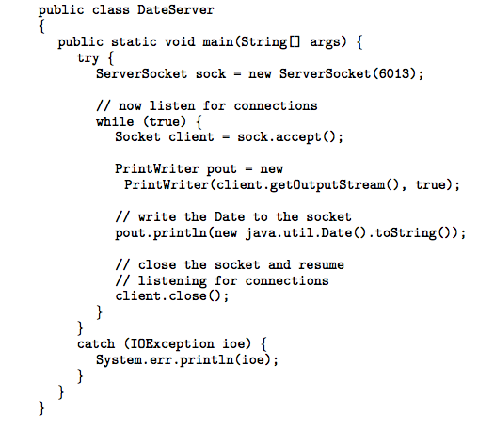
Socket Communication in Java

Slide 50
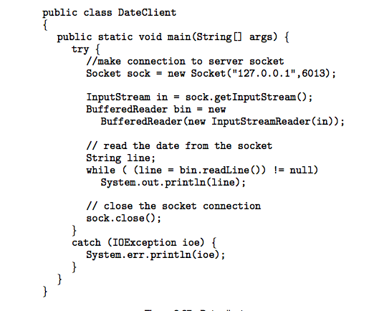
Socket Communication in Java

Slide 51
Remote Procedure Calls
Remote procedure call (RPC) abstracts procedure calls between processes on networked systems.
Stubs – client-side proxy for the actual procedure on the server.
The client-side stub locates the server and marshalls the parameters.
The server-side stub receives this message, unpacks the marshalled parameters, and peforms the procedure on the server.

Slide 52
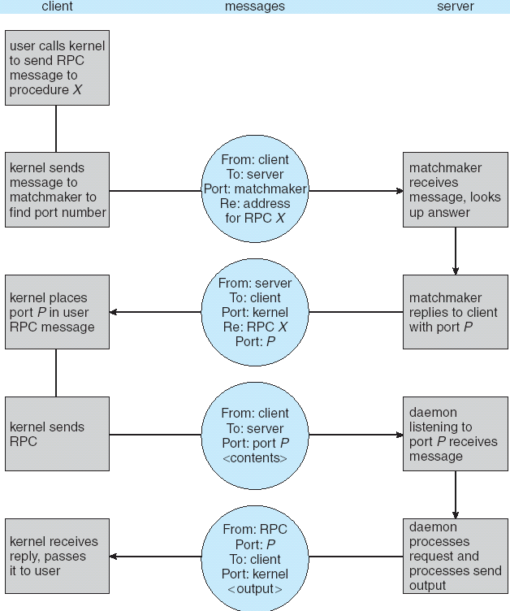
Execution of RPC

Slide 53

Remote Method Invocation
Remote Method Invocation (RMI) is a Java mechanism similar to RPCs.
RMI allows a Java program on one machine to invoke a method on a remote object.

Slide 54
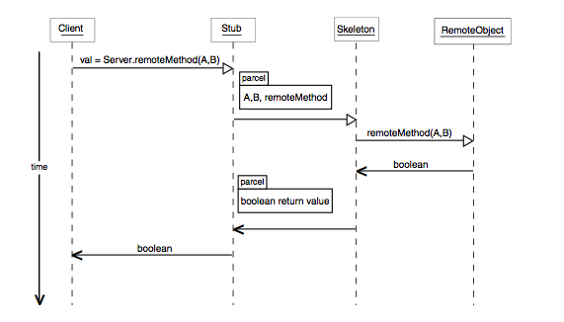
Marshalling Parameters

Slide 55
End of Chapter 3

Slide 56
Backup Foils

Slide 57
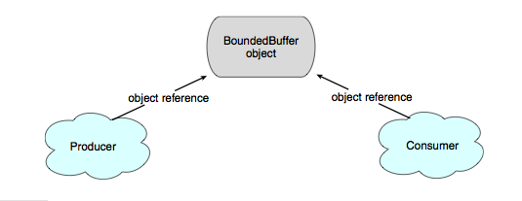
Simulating Shared Memory in Java

Slide 58
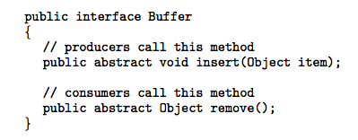
Bounded-Buffer – Shared-Memory Solution

Slide 59
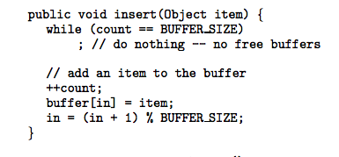
Bounded-Buffer -- Figure 3.16 - insert() method

Slide 60
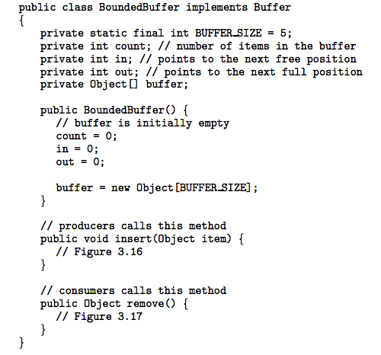
Bounded-Buffer – Shared-Memory Solution

Slide 61
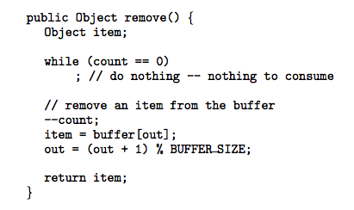
Bounded-Buffer – Figure 3.17 - remove() method

Slide 62
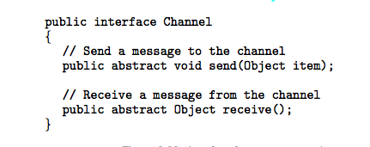
Bounded-Buffer – Message Passing Solution

Slide 63
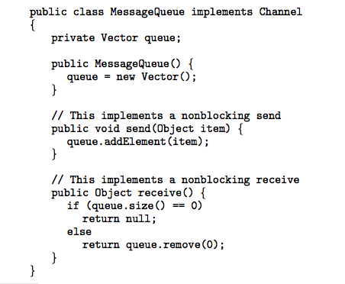
Bounded-Buffer – Message Passing Solution

Slide 64
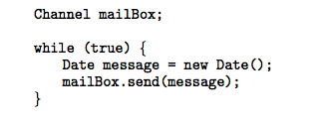
Bounded-Buffer – Message Passing Solution
      The Producer

Slide 65
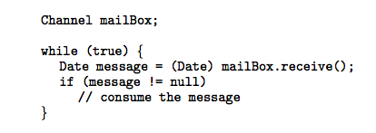
Bounded-Buffer – Message Passing Solution
      The Consumer

Slide 66
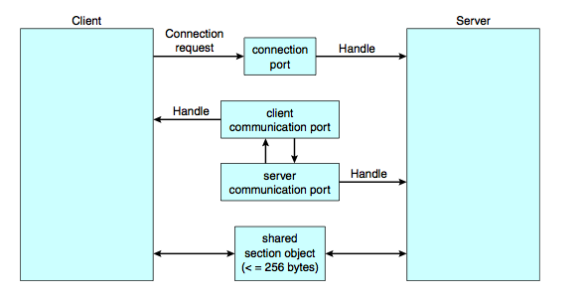
Message Passing in Windows XP

Slide 67

RMI Example

Slide 68
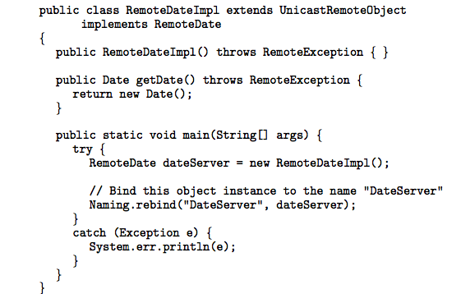
RMI Example

Slide 69
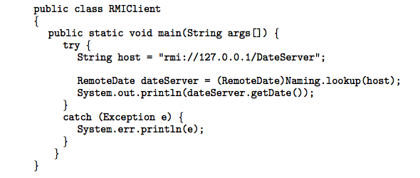
RMI Example

